Slide 1

SSD Feature Detection
Jan Nalivaika

Slide 2
State of the art / Based on
https://github.com/PeizhiShi/SsdNet
24 Features
Working on a cube
Overlapping Features
SSD Provides Positioning and Labeling

Slide 3
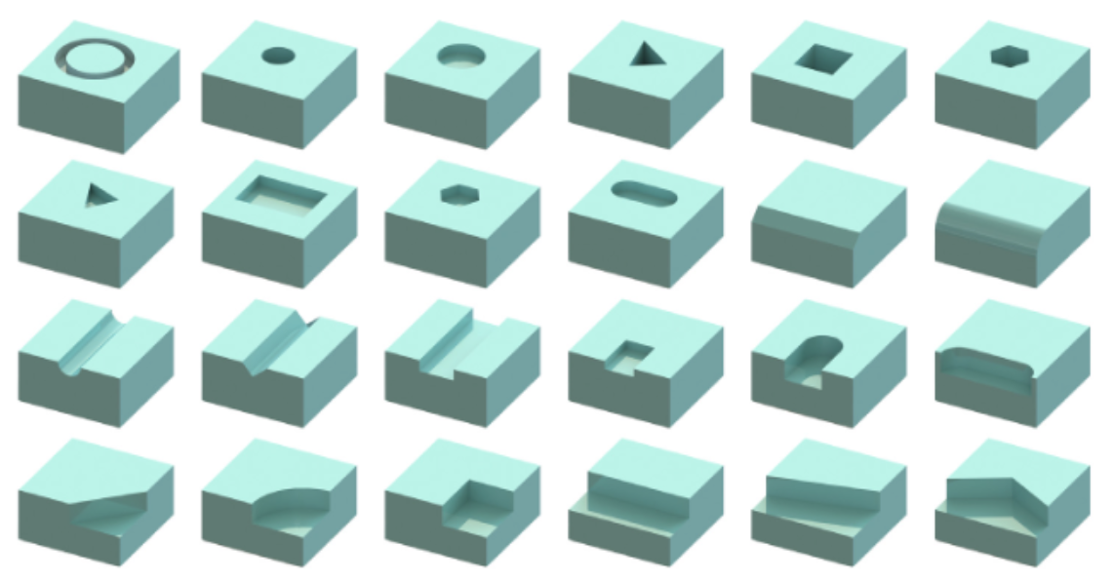
24 Features

Slide 4
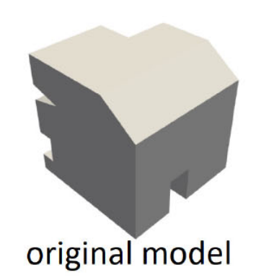
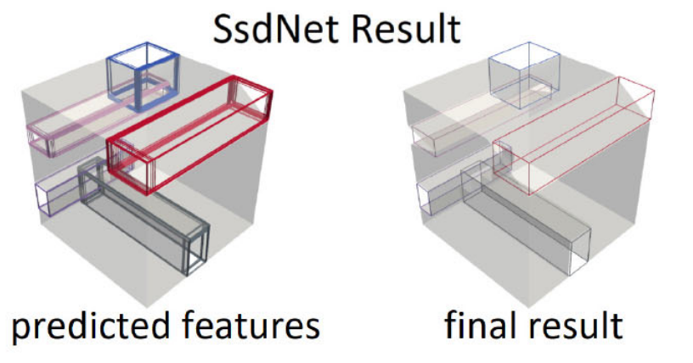
Localization Example

Slide 5
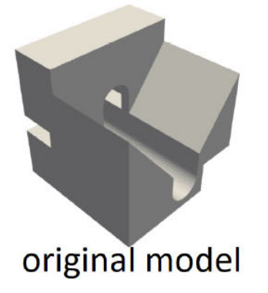
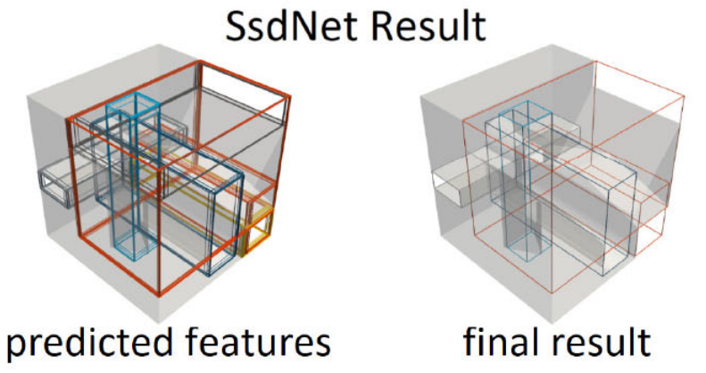
Localization – Example 2

Slide 6
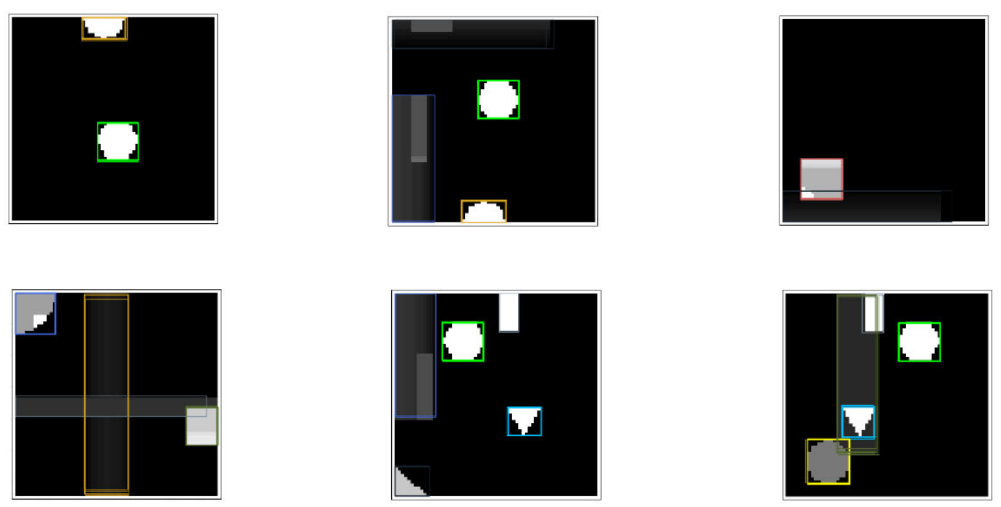
Localization – Example 3
Looking at the cube from 6 directions
Getting X,Y,Z values as well as label
➔ Positioning in 3D space possible

Slide 7
At least 3 big Problems with the current State of the art
P1) Only working on cubes ☹ ➔ Parts in engineering are almost never a cube
P2) Localization is only possible on faces parallel to axis ☹ ➔ Faces are not always parallel to the viewing angel
P3) Features are only recognized if they are in a certain orientation ☹ ➔ Features may be on a plane orthogonal to the viewing angle but turned in the plane
Multiple smaller bottlenecks that hinder the implementation as a full-scale service

Slide 8
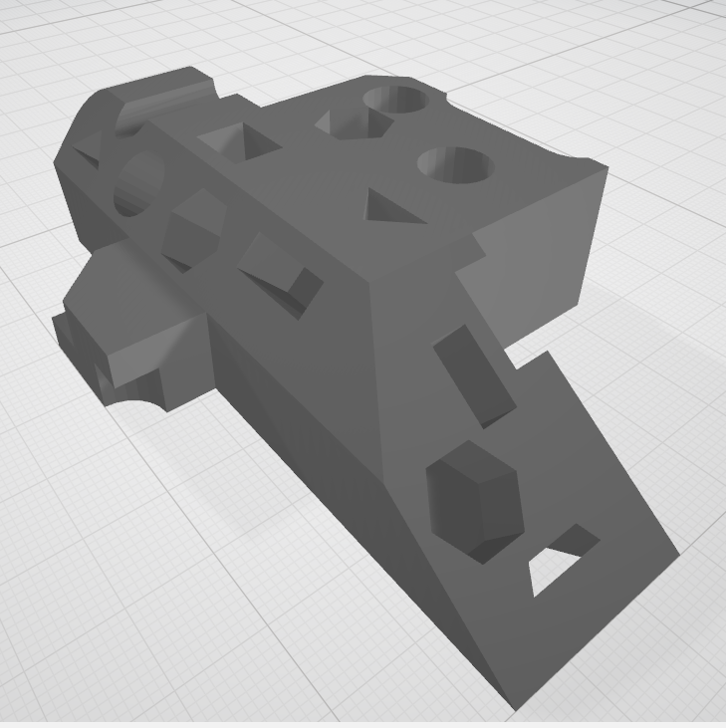
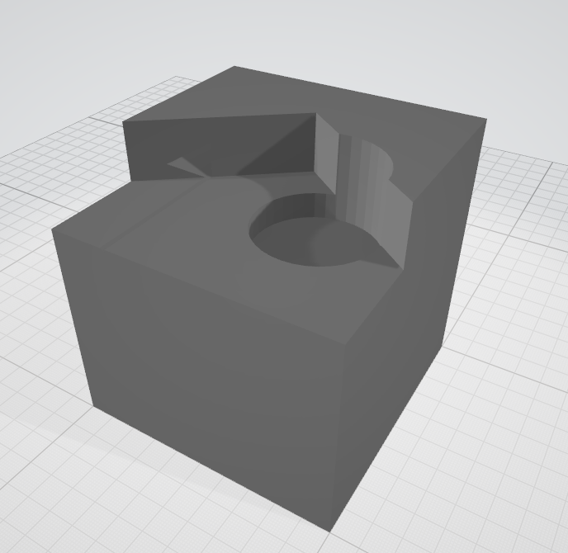
Problem 1) Only working on cubes
But how to detect features on an object like this ?
Current state of the art
Notes:
Text: rterterterter
Addition info: lasdkjflkasdjf

Slide 9
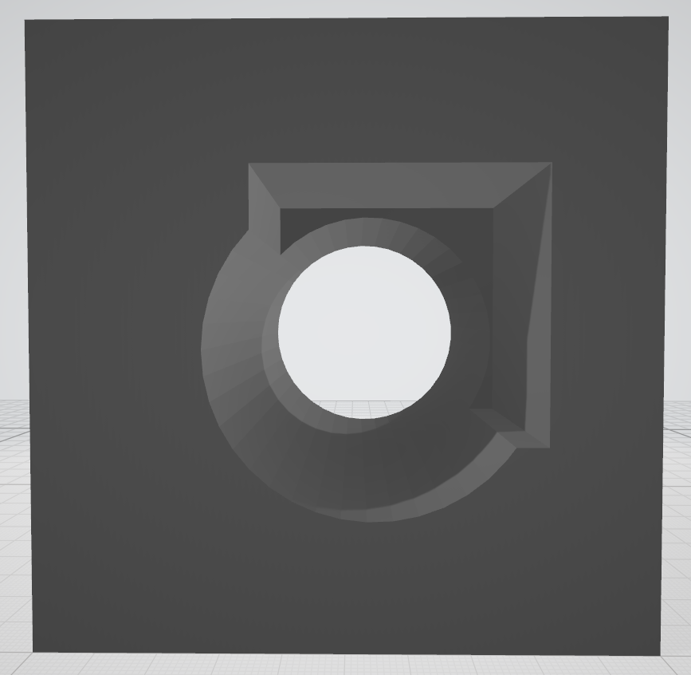
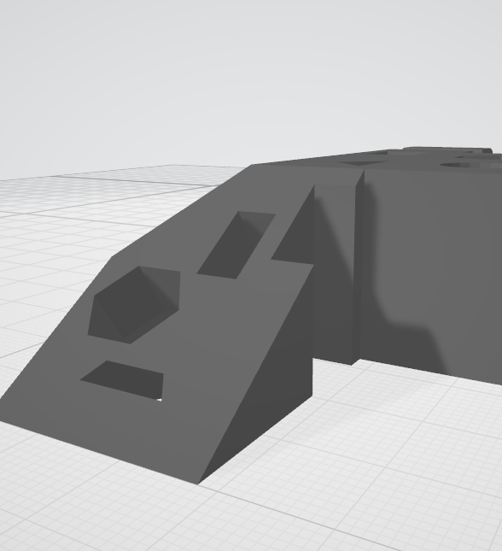
Problem 2) Localization is only possible on faces orthogonal to viewing angle
But how to detect features that is on a slope
If a feature is on a plane that is facing us, we can localize it

Slide 10
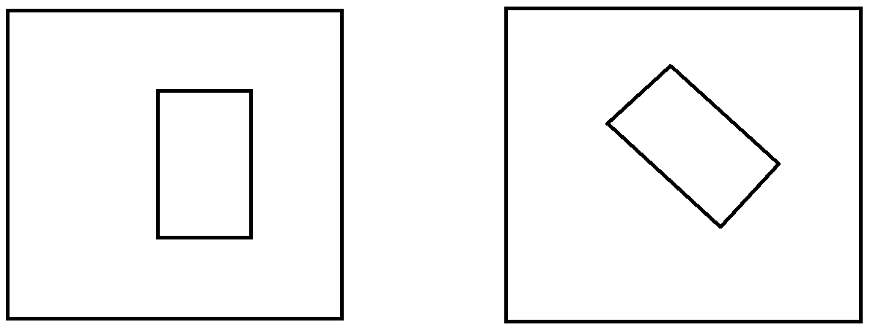
Problem 3) Features are only recognized if they are in a certain orientation
It is possible to detect this feature (rectangular through hole) because it was in the training set
How to detect the same feature if it is on an angle relative to the local coordinate system

Slide 11
The New Approach – Start to Finish
Have a STL-file
Voxelize the STL file
Create HD-Pictures (.png) with the help of the voxelized file
Segment the HD pictures into smaller pictures that can be used as input for the NN (solving problem 1)
Run the Recognition and save the data (Position & labels)
Turn the STL-file so the that slopes are now orthogonal to the viewing position
This step is repeated until all major planes are at least ones viewed orthogonally
Go to step 5
Place all information in 3D space on the STL file

Slide 12
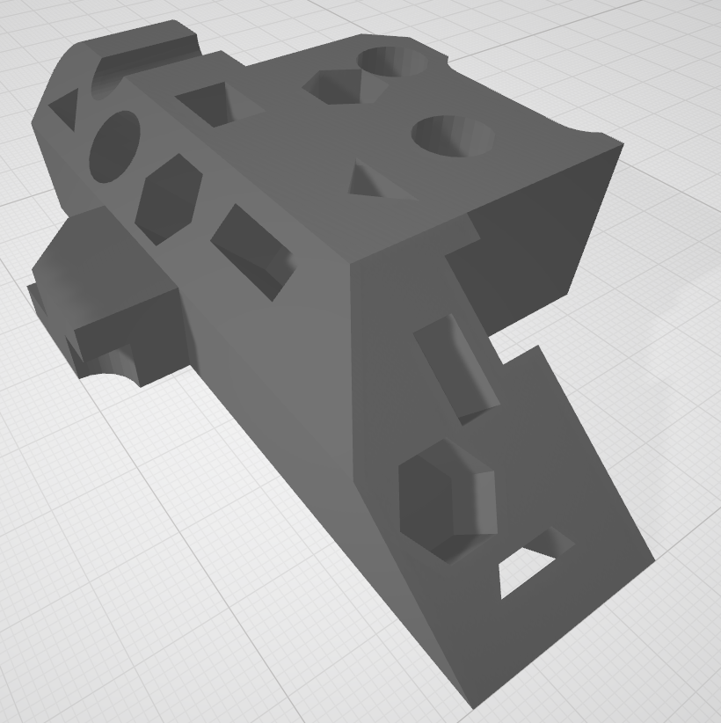
1) Have a STL file

Slide 13
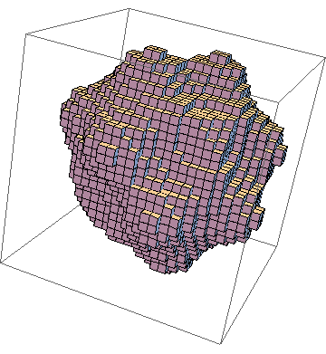
2) Voxelize the STL file
This example is not related to the original STL file – only for visualization
STL-file is converted to voxels that are positioned in 3D space
Original Problem:
Voxelization only possible with an external script with a maximum dimension of 512*512*512 voxels ☹
Developed solution:
-Voxelization now possible with python
-The only limitation is RAM (atm. 3000*3000*3000 Voxels with 16 GB of RAM )

Slide 14



3) Create HD-Pictures with the help of the voxelized file (1/2)
Viewed from BACK
Viewed from TOP
Viewed from FRONT

Slide 15



3) Create HD-Pictures with the help of the voxelized file (2/2)
Viewed from LEFT
Viewed from BOTTOM
Viewed from RIGHT

Slide 16
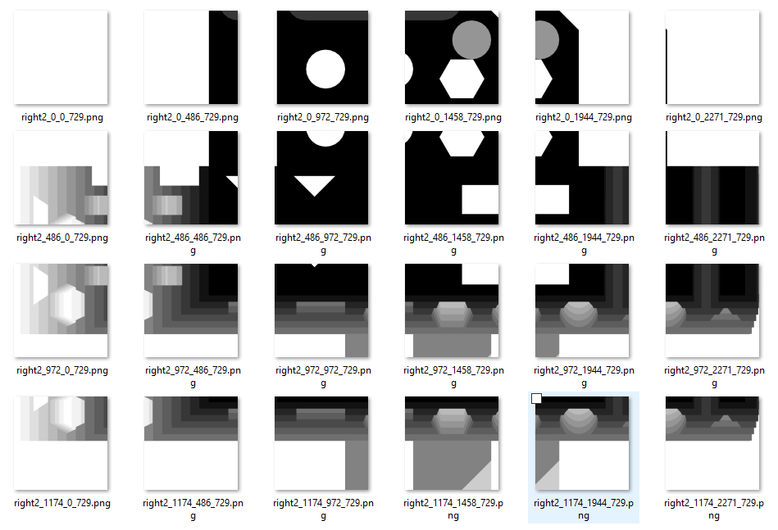
4) Segment the HD pictures into smaller picture that can be used as input for the NN
The NN only accept pictures 64pix * 64pix
SEGMENTATION
Original Size = 3000 pix *1200 pix
The segmentation algorithm divides each HD picture into squares with overlap and resizes them if necessary to 64pix * 64pix

Slide 17
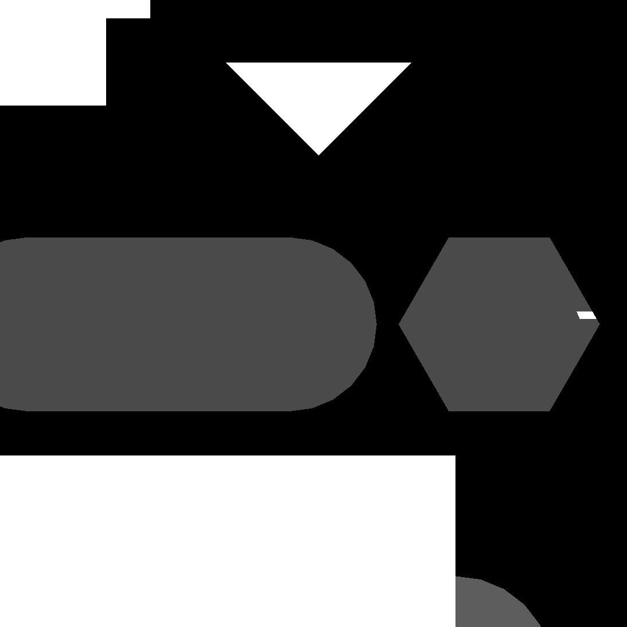
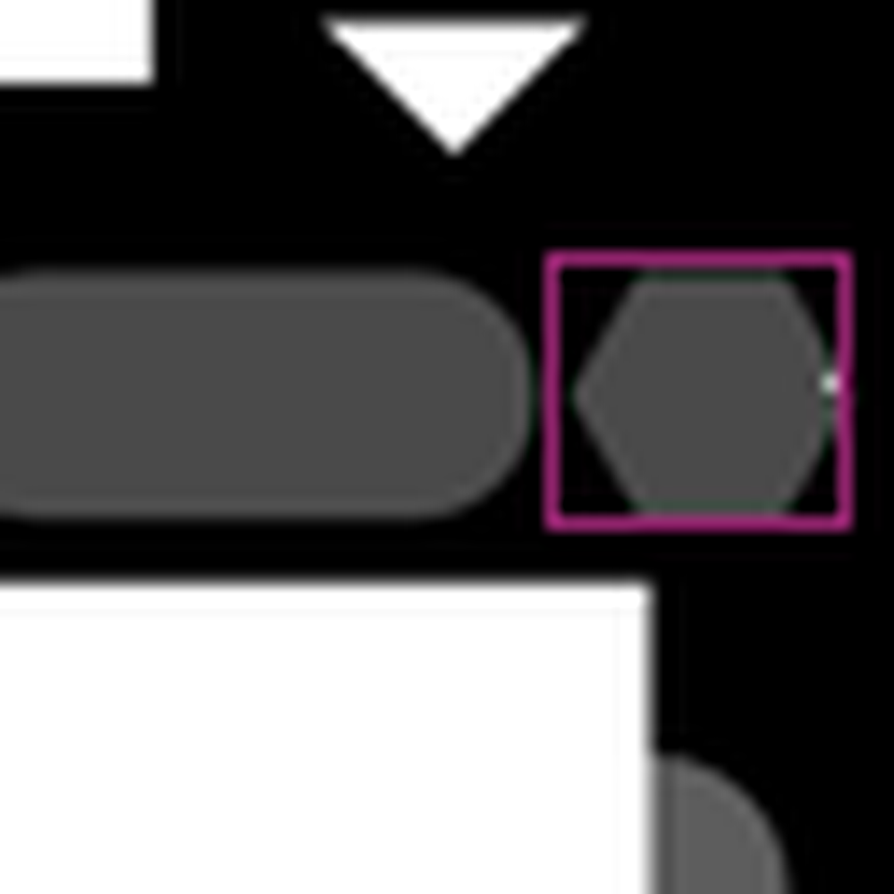
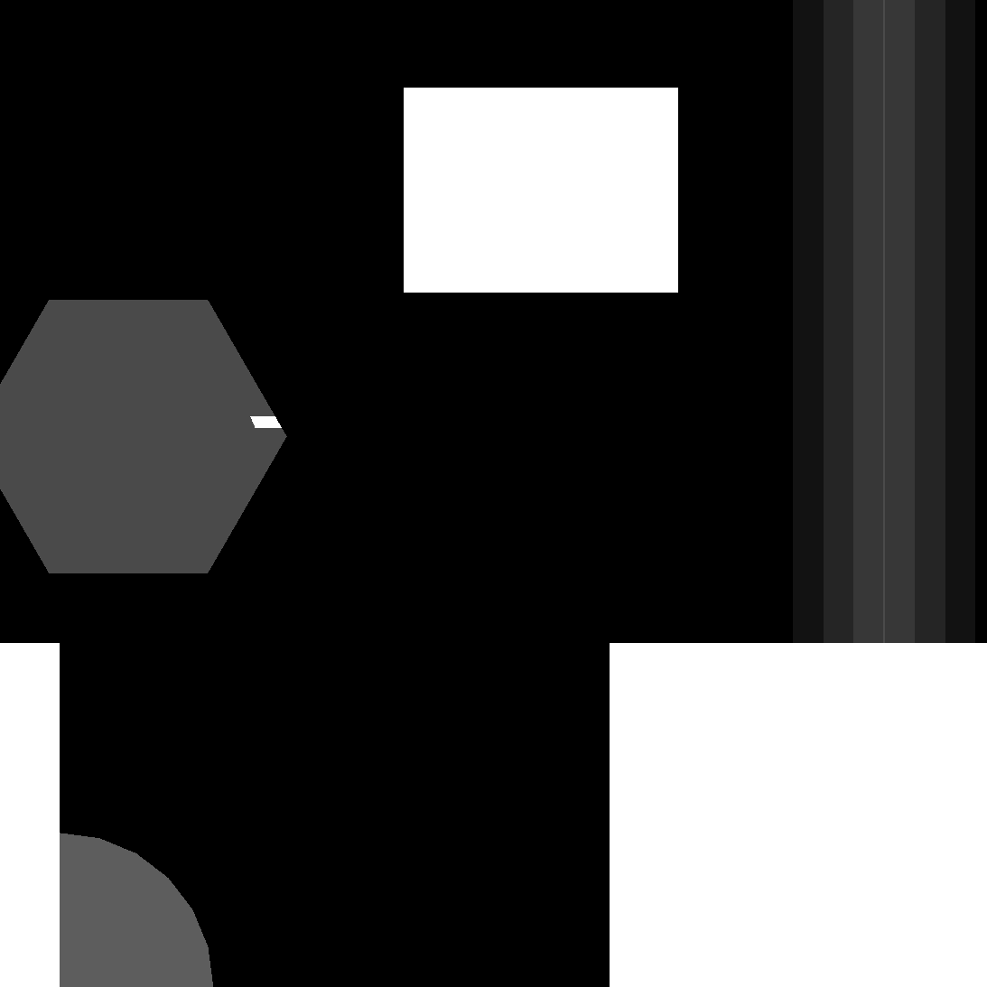

5) Run the Recognition and save the Data (Position & labels)
Found a V-groove
Found a hexagon

Slide 18
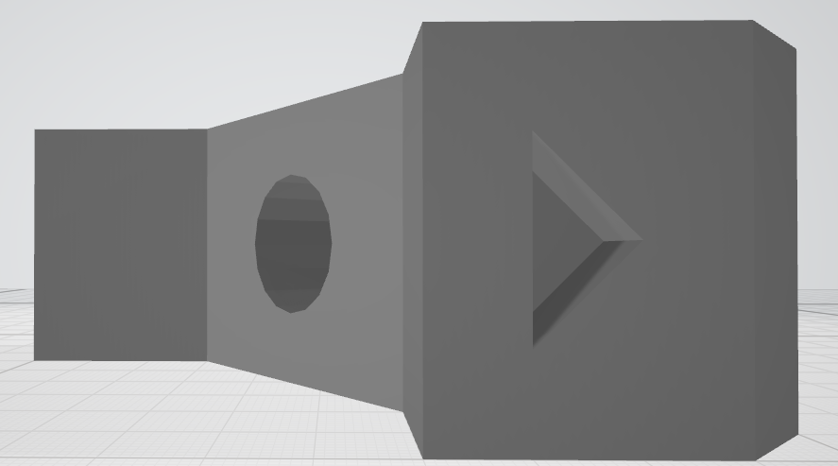
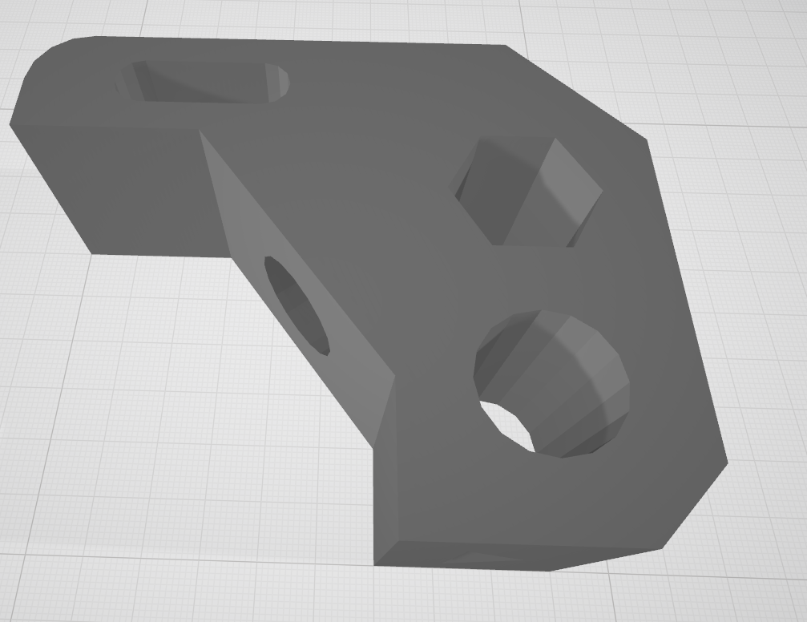
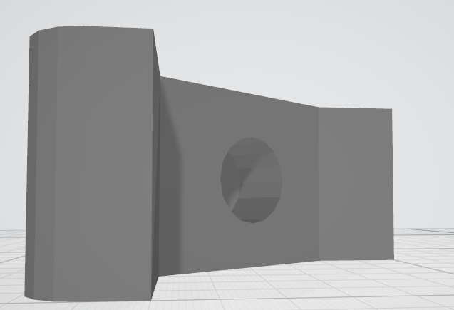
6) Turn the STL file so the that slopes are now orthogonal to the viewing position – Problem 2
Viewing angle 1
Viewing
angle 2
Viewing angle 2
Viewing angle 1
Easy to recognize and locate triangular blind hole
Not possible with circular blind hole ☹
STL-File with a blind hole on a slope

Slide 19
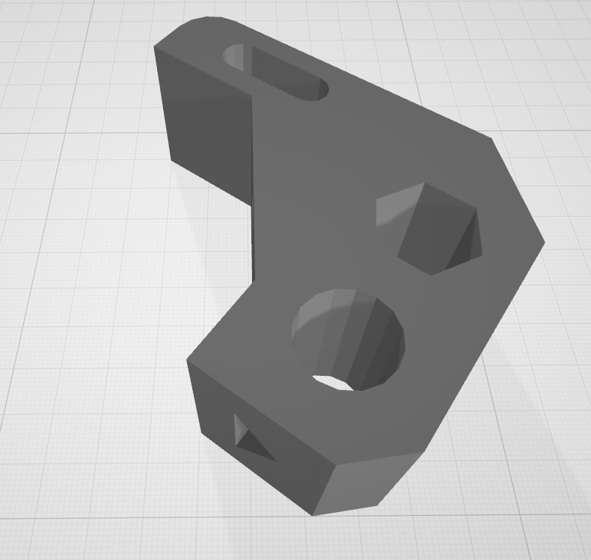
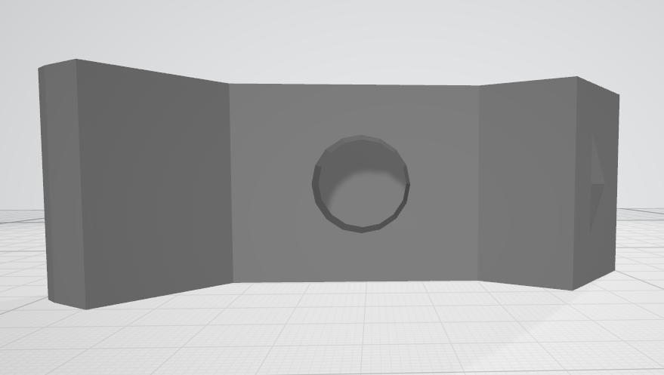
6) Turn the STL file so the that slopes are now orthogonal to the viewing position – Solution
Viewing angle 2
Viewing
angle 2
Viewing angle 1
STL-File with a blind hole on a slope
!Now turned!
Now easy to recognize and locate from viewing angle 2

Slide 20
TODO
Work on step 6) Turn the STL file – Not yet implemented in the loop, only standalone
Work on step 7) Place all information in 3D space on the STL file – No progress yet
Improve runtime – Successfully lowered from 7 hours to 20 min for one loop – goal is 5 min
Check out Equivariant Steerable CNNs to solve problem 3 (https://github.com/QUVA-Lab/e2cnn)
Solve problem 3 by just turning the raw picture till feature is occupying smallest BB
Design small scale validation test (Check evaluation metric)
Add more features for recognition (Automatic data-set creation)
Increase NN resolution from 64 to 128 (if necessary)
What is the best aspect ratio to find features

Slide 21
Ideas:
Replace STL turning with matrix turning ?

Slide 22
Problems
Not recognizing features on cube anymore (wrong training data) ?
Find differences in HD and low-res cubes
New training-set required
JPGS in weird dimension after turning
Slicing not working on cubes

Slide 23


Different pictures ?
Preprogrammed confusion with hexagon
working
Now working ?

Slide 24
Same pictures
On the same NN
Different result
WHY ????

Slide 25

Difference in images

